Slide 1
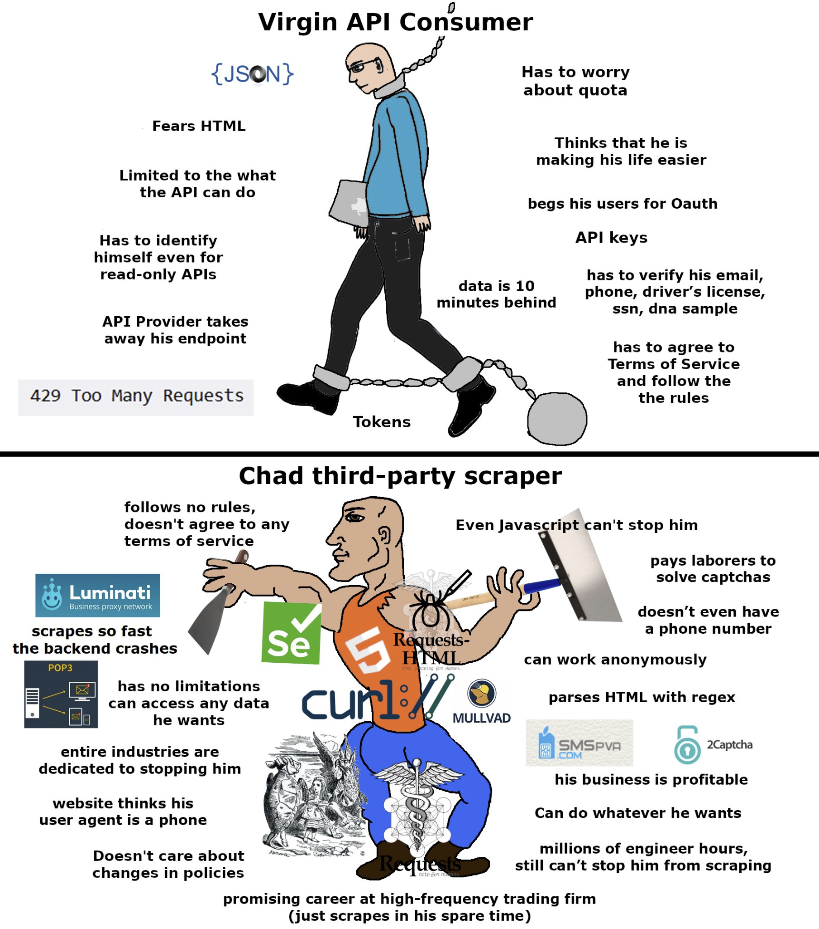
COMP2041
Week 4

Slide 2
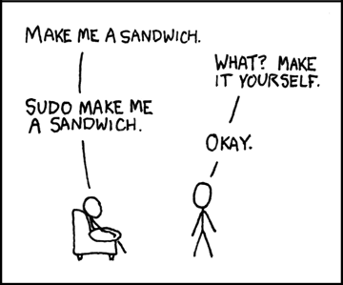
Announcements
Welcome to Week 4 of COMP2041
Lab 3 due Monday 12PM AEDT
Week 03 Weekly Test due Thursday 9PM AEDT
Help session schedule has been released
Caution: Always very busy during assignment time, arrive early

Slide 3
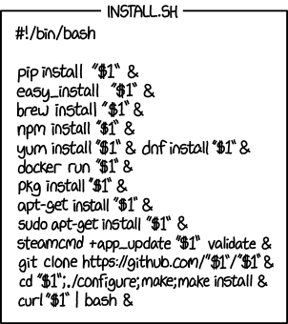
Overview
No new real content
case, read, function
Tutorial Questions

Slide 4
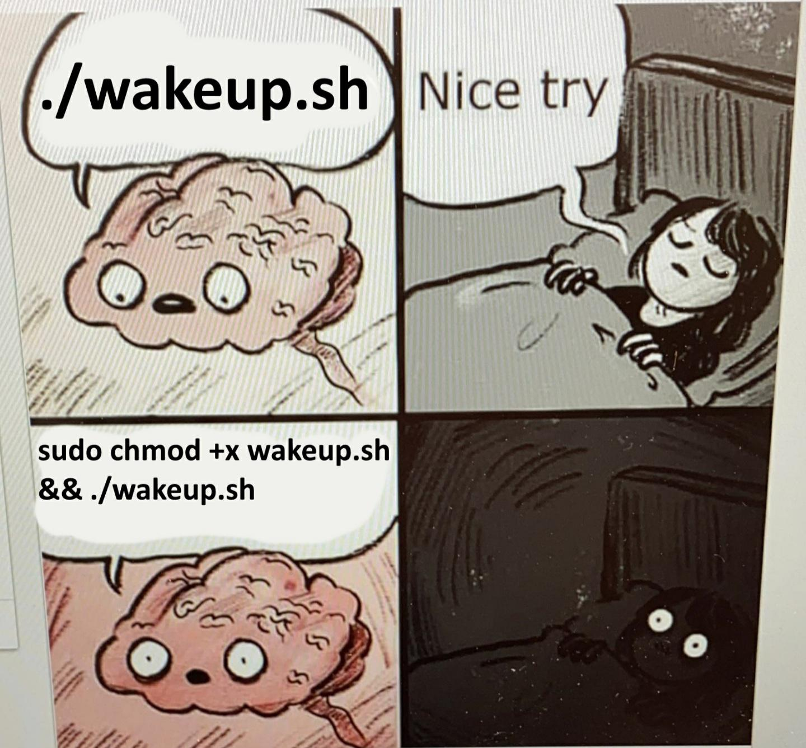
read
Reads from input.
read –p
while read line

Slide 5

case
Simplifying if / elif / else statements
Examples -

Slide 6
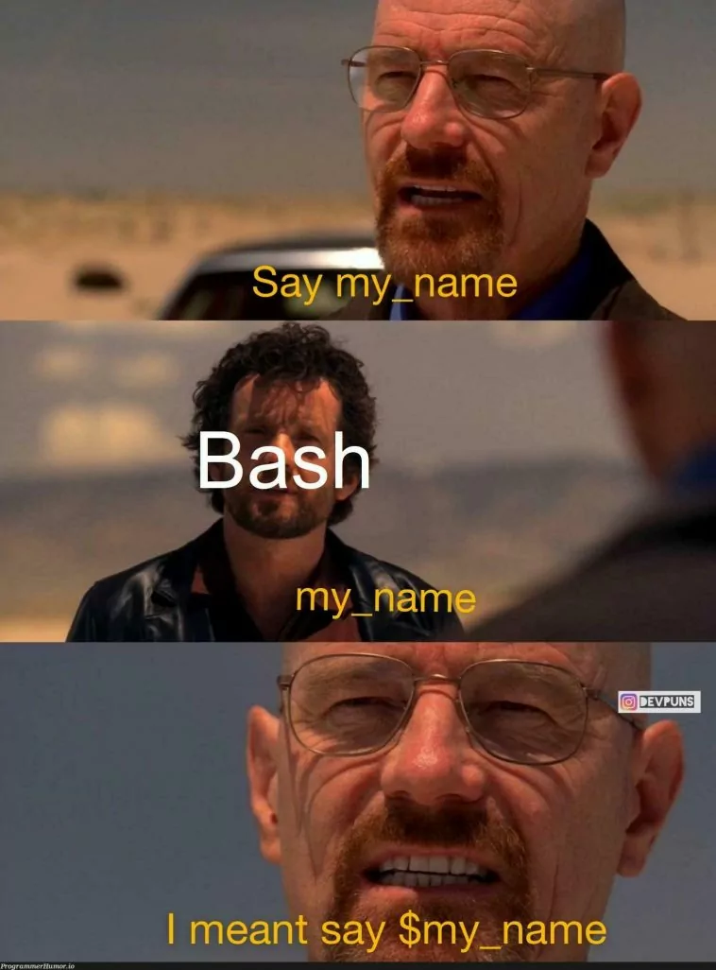
function
Helps us encapsulate reusable blocks of code, making scripts more modular and easier to maintain. (Basically the same thing from what we’ve been doing so far)
Examples -

Slide 7

Tutorial Questions

Slide 8

To The
Lab!

